Slide 1

EVALUATION
Prof. S K BAWA
Central University of Punjab
Bathinda

Slide 2
Process of judging the value or worth of an individual’s achievements
Decision making process that leads to suggestions for actions to improve effectiveness and efficiency
Process to determine to what extent the educational objectives are achieved

Slide 3

    Learning
Assessment of student’s learning
Assessment of Teacher’s teaching

Slide 4
Formative Evaluation
for students
  Learning the subject matter
  Mastery of learning
  Goal of learning
  Sequence of learning
  Effective reinforcement
  Diagnostic value
for Teacher
  Locating errors
  Quality control

Slide 5

Summative Evaluation
  Basis of assigning grades
  Basis of certification
  Predicting success
  Knowledge of progress
  Beginning of instruction
  Comparison of groups
  Placement Evaluation
  Position of the learner
  Information about the learner
  Useful for learner
  Firm foundation
  Avoiding duplicacy

Slide 6
  Diagnostic Evaluation
  Finding strength and weakness
  Finding causes of problem
  Solution of problems
  Designing curricula
  Knowledge of progress
  Providing guidance

Slide 7
Test- to determine a student’s ability
  to complete certain tasks or demonstrate mastery of a skill or knowledge of content.
  multiple choice tests, essay or true/false tests
Assessment- process of gathering information –both qualitative and quantitative, to monitor progress and make educational decisions.
In the classroom, assessment considers performances of students on a variety of tasks in a variety of settings.

Slide 8
Measurement
- process of obtaining a numerical description of the degree to which an individual possesses a particular characteristic.
Evaluation
- Procedures used to determine whether the student meets a predetermined criteria.
This uses assessment techniques to determine whether the student qualifies or not.

Slide 9

WHY?
Provides short-term feedback about day-to-day teaching/learning
Provides useful information about student learning with a much lower investment of time
Helps foster good rapport with students

Slide 10

Encourages teaching as a formative process
Students become monitors of their own learning
Illuminates needed study skills
Demonstrates teacher cares about student learning

Slide 11
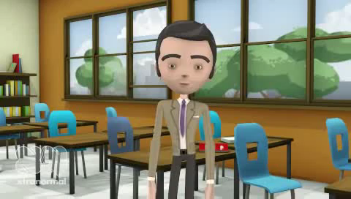
video

Slide 12

Process of
MEASUREMENT/EVALUATION/ASSESSMENT

Slide 13
Learning Level
Clarifying the intended learning outcomes
Providing short-term goals to work
Offering feedback concerning learning progress
Providing information for overcoming learning difficulties and selecting future learning experiences.

Slide 14
Teaching Level
The effectiveness of the instructional methods
The usefulness of the instructional materials
The appropriateness and attainability of the instructional objectives

Slide 15
Guidance and counselling level
Assisting pupils with educational and vocational decisions
Guiding them in the selection of curricula and extracurricular activities
Helping them solve personal and social adjustment problems

Slide 16
Curriculum development level
State the intended learning outcomes in terms of how the pupils are expected to perform at the end of the unit.
List the instructional materials and learning activities for the unit.
Describe the evaluation procedure to be used for determining pupil progress toward the intended learning outcomes.

Slide 17
Administration level
Institution objectives are being achieved
To identify the curriculum’s strengths and weaknesses
To appraise special programmes in the institution
To base administrative decisions concerning the placement
Grouping and promotion of pupils.

Slide 18
Classroom research level
Effectiveness of different curricula
Different teaching methods
Different organizational plans which require objective measures of pupil’s performance.

Slide 19
Measurement | Evaluation
Focus is on a single aspect of subject matter achievement/skill | Emphasis on overall pupil growth
Not based on predetermined objectives | Based on a wide range of objectives
Limited in scope | Concerned with total personality of the pupils
Is a means to an end | Is an end in itself
Is done as and when required | Is a continuous process
Uses a limited set of techniques | Uses a variety of techniques

Slide 20


Slide 21
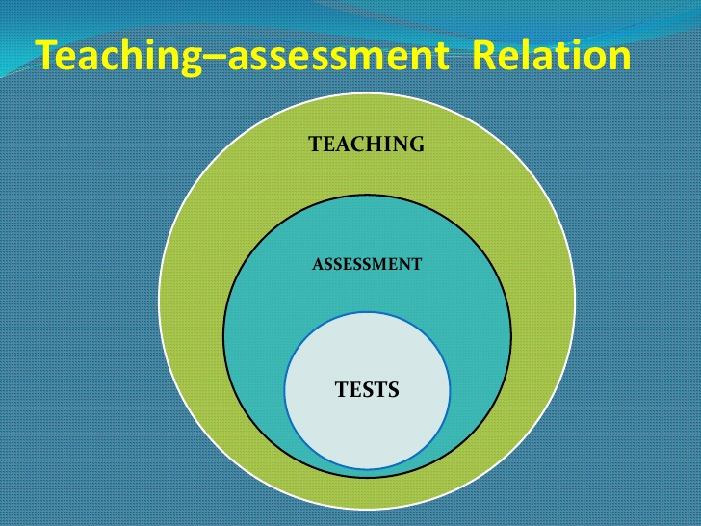

Slide 22
  Framing of
  Questions
  for Tests

Slide 23
Bloom’s Taxonomy
Creating
Evaluating
Analyzing
Application
Understanding
Remembering

Slide 24
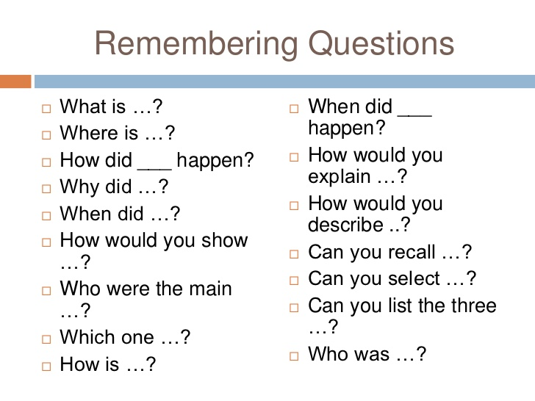

Slide 25
Remembering Question
What is the internal structure of a root?

Slide 26
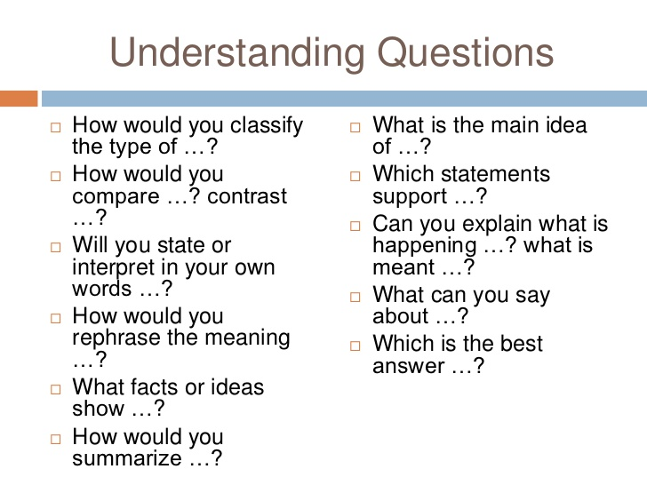

Slide 27
Understanding Questions
How does the gravity affect movement of water in a plant?

Slide 28
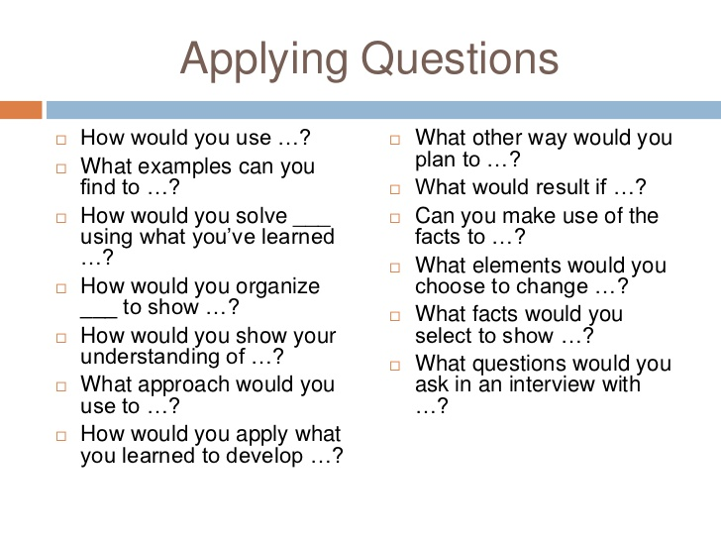

Slide 29
Applying Questions
How Yeast bakes a cake?

Slide 30
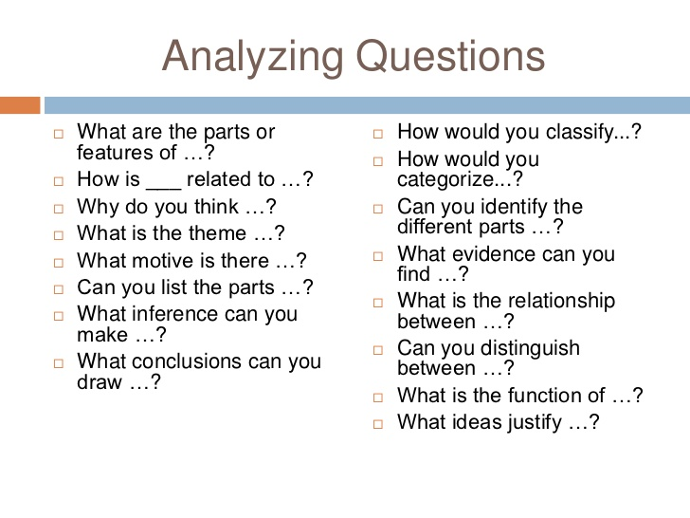

Slide 31

Analyzing Question
How does simple amoeba evolved to form complex structures such as humans and animals?

Slide 32
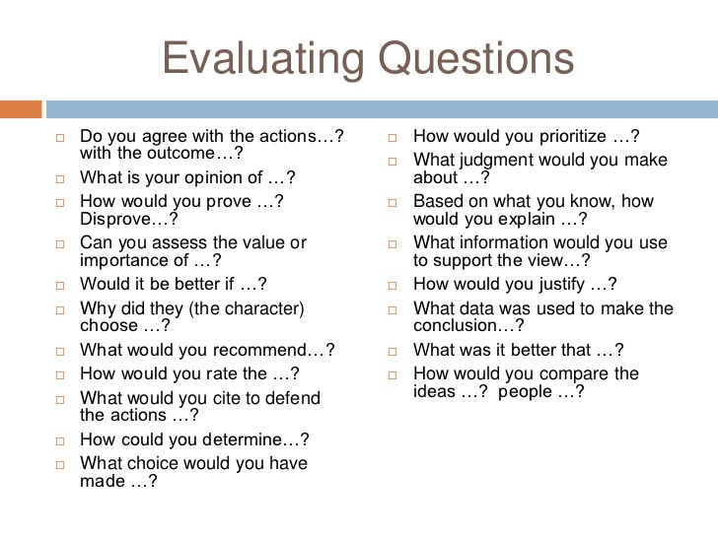

Slide 33
Evaluating Question
What evidences support the conclusion that complex higher animals are evolved from simple organisms like amoeba?

Slide 34
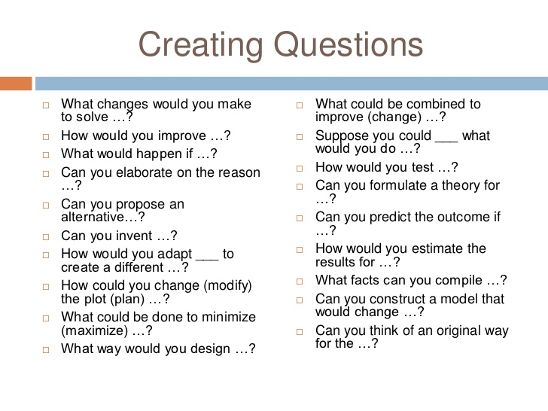

Slide 35
  Creating Questions
  Using your knowledge of photosynthesis how can you design a solar cell?

Slide 36
Determining Types of Questions
    Subjective Objective
    Essay Type -
      Understanding
      Application MCQ
    Short answer type Fill ups
      Remembering True/False
      Evaluating Completion
      Creating
      Analyzing
      Very short answer type

Slide 37

CLASSROOM EVALUATION TECHNIQUES

Slide 38
Minute Paper
PROCESS
The teacher will divide the class into groups. Each group will be randomly given one module out of the total modules taught. Every student will get an envelope containing one question from the module of the group. The student will reply in 2 minutes.
COGNITIVE SKILLS
Recall, Memory, Understanding, Focused thinking, Analytical Thinking,
APPLICATION
The courses having L and T components

Slide 39
Student Generated Test Question
Process The student will be asked to frame two questions (one long answer and one short ) from the topic announced by the teacher on the spot and on random basis to each group. Each student will reply in 2 minutes. The teacher will evaluate separately the framing / answering to the questions. | Cognitive Skills Knowledge Recall Memory Understanding Divergent thinking Analytical Thinking | Application The courses having L and T components and also with P component

Slide 40
Application Card
Process The teacher will divide the class into three / four groups. Each group will be randomly given one topic out of the total topics taught. Every student will get an envelope containing one stimulus from the topic of the group. The application of that stimulus is to be replied in 2 minutes. | Cognitive Skills Knowledge Memory Understanding Divergent thinking Analytical Thinking Application | Application The courses having L and T components and also with P component

Slide 41
Case Analysis
Process The teacher will assign pre identified cases to each group of students (4/5 groups) The student will analyze the case and reply in 5 minutes. | Cognitive Skills Understanding Focused thinking Analytical Thinking Divergent thinking Application | Application The courses having L and T components and also with P component

Slide 42
Simulated Problem Solving
Process The teacher will create hypothetical data for each student. Every student will be assigned the problem on the spot to solve in 5 minutes. | Cognitive Skills Knowledge Memory Understanding Divergent thinking Analytical Thinking Application | Application The courses having numerical application

Slide 43
Media Assisted Evaluation
Process The teacher will show any video/ e content/televised lesson to students. The students will watch and critically analyze the programme and will submit the report in 5 minutes. | Cognitive Skills Understanding Focused thinking Analytical Thinking Divergent thinking Application | Application The courses having L and T components

Slide 44
Video Based Minute Paper
Process The teacher will show any video/ e content/televised lesson to students. The students will watch and reply to one question in writing which will be randomly given to each student | Cognitive Skills Understanding Focused thinking Analytical Thinking Divergent thinking Application | Application The courses having L and T components

Slide 45
STOP LIGHT METHOD
STICKY NOTES
Green
What they have learnt
Yellow
Any idea or question, they want to give
Red
My Learning stopped because..…

Slide 46
Evaluation reforms in view of high-tech academic inputs
Evaluate their own learning
To give information how to improve
Multiple opportunities to achieve high grades
Help them to keep their own records for personal improvement

Slide 47

BE BETTER TEACHER WITH
SMART FEEDBACK

